Slide 1



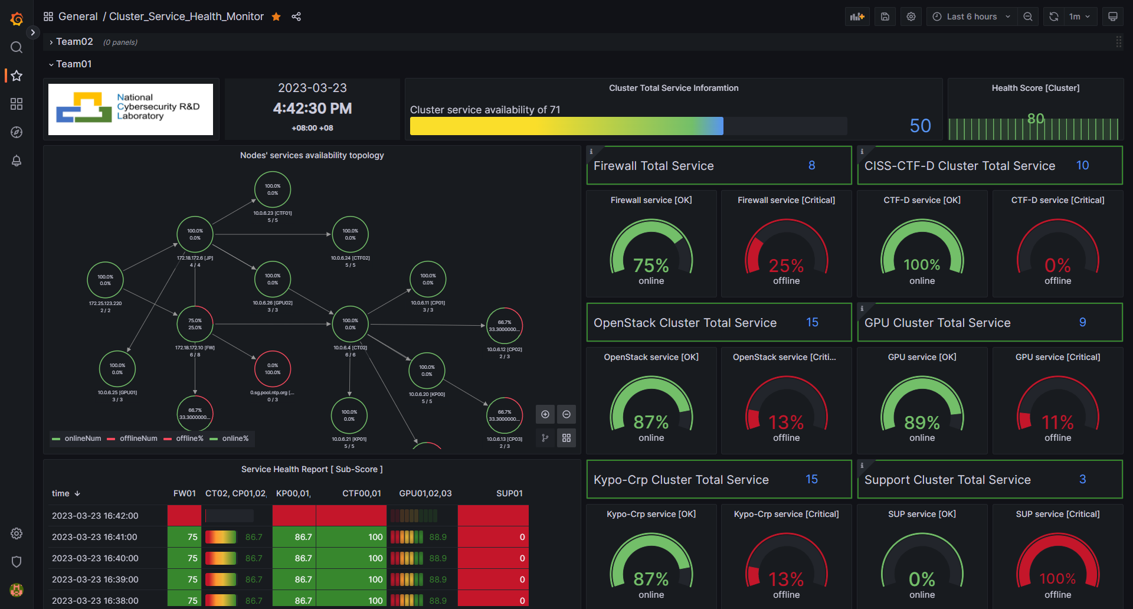




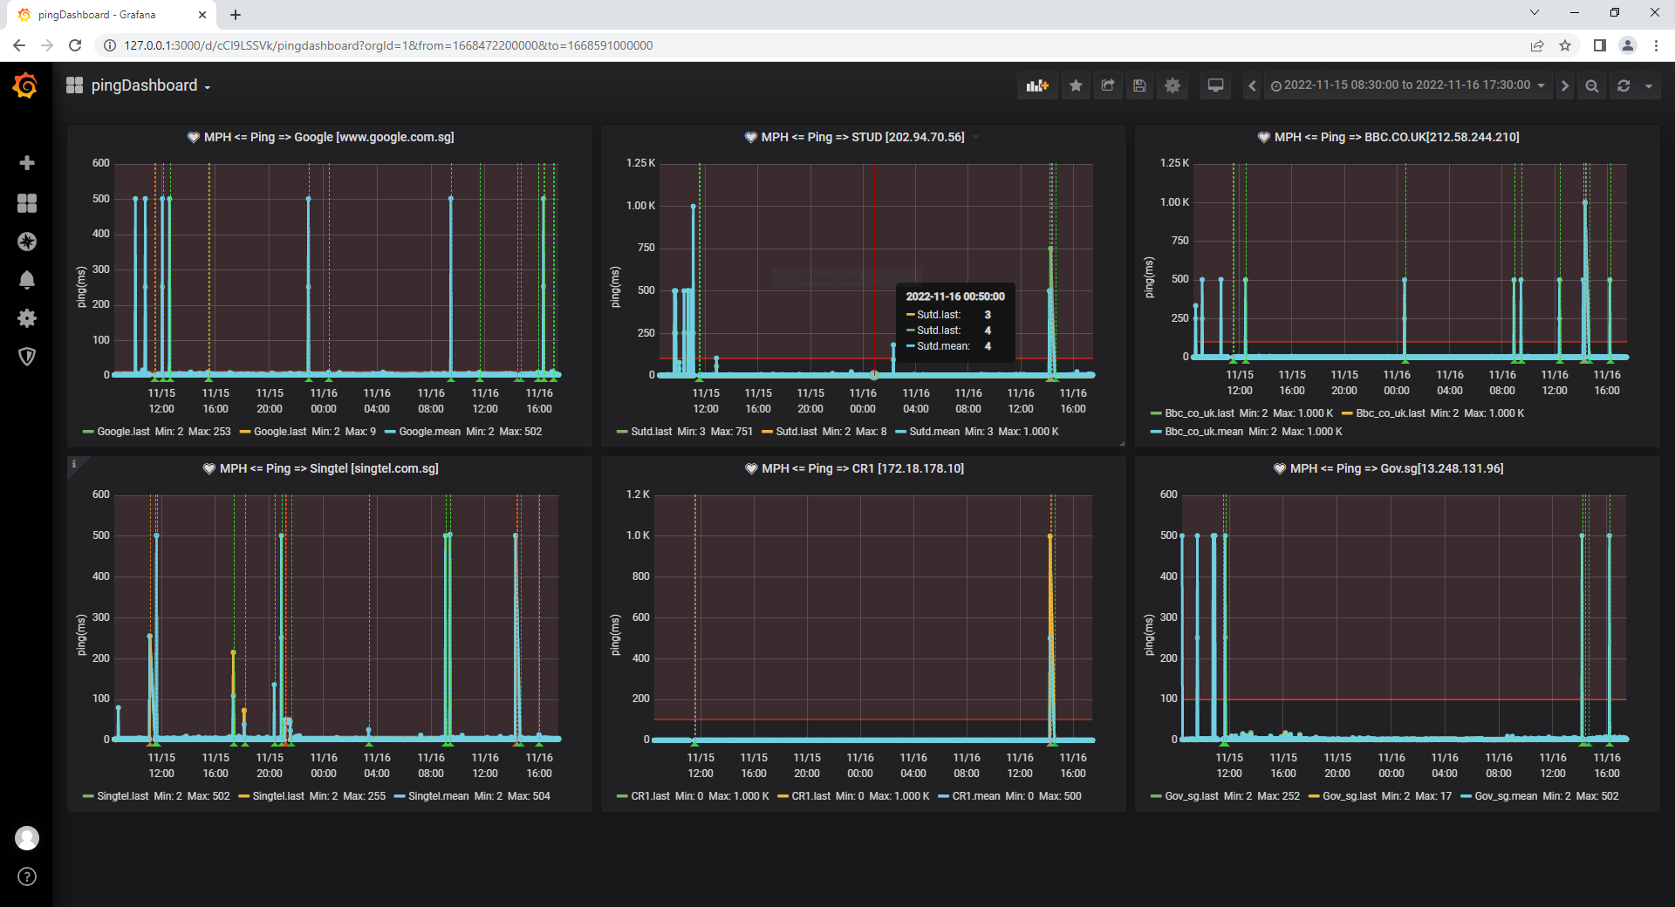



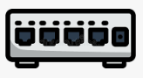
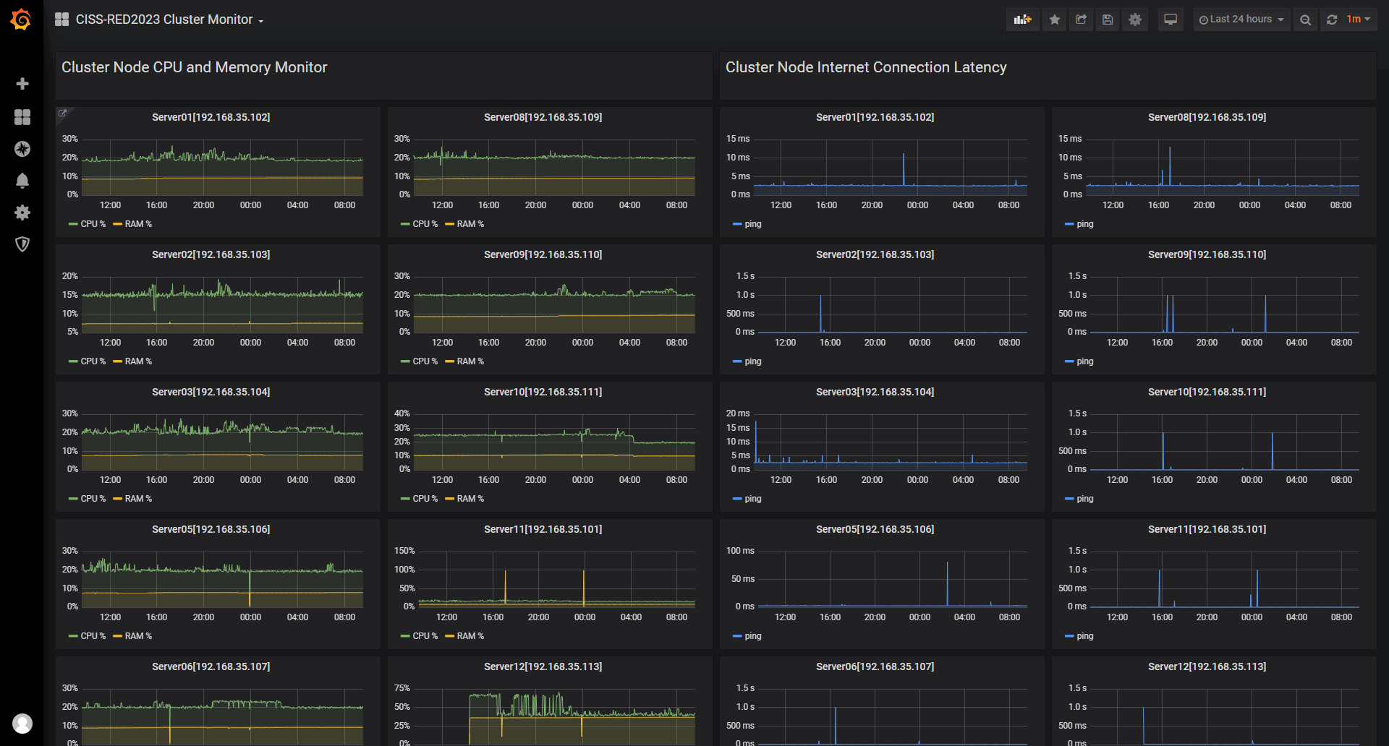

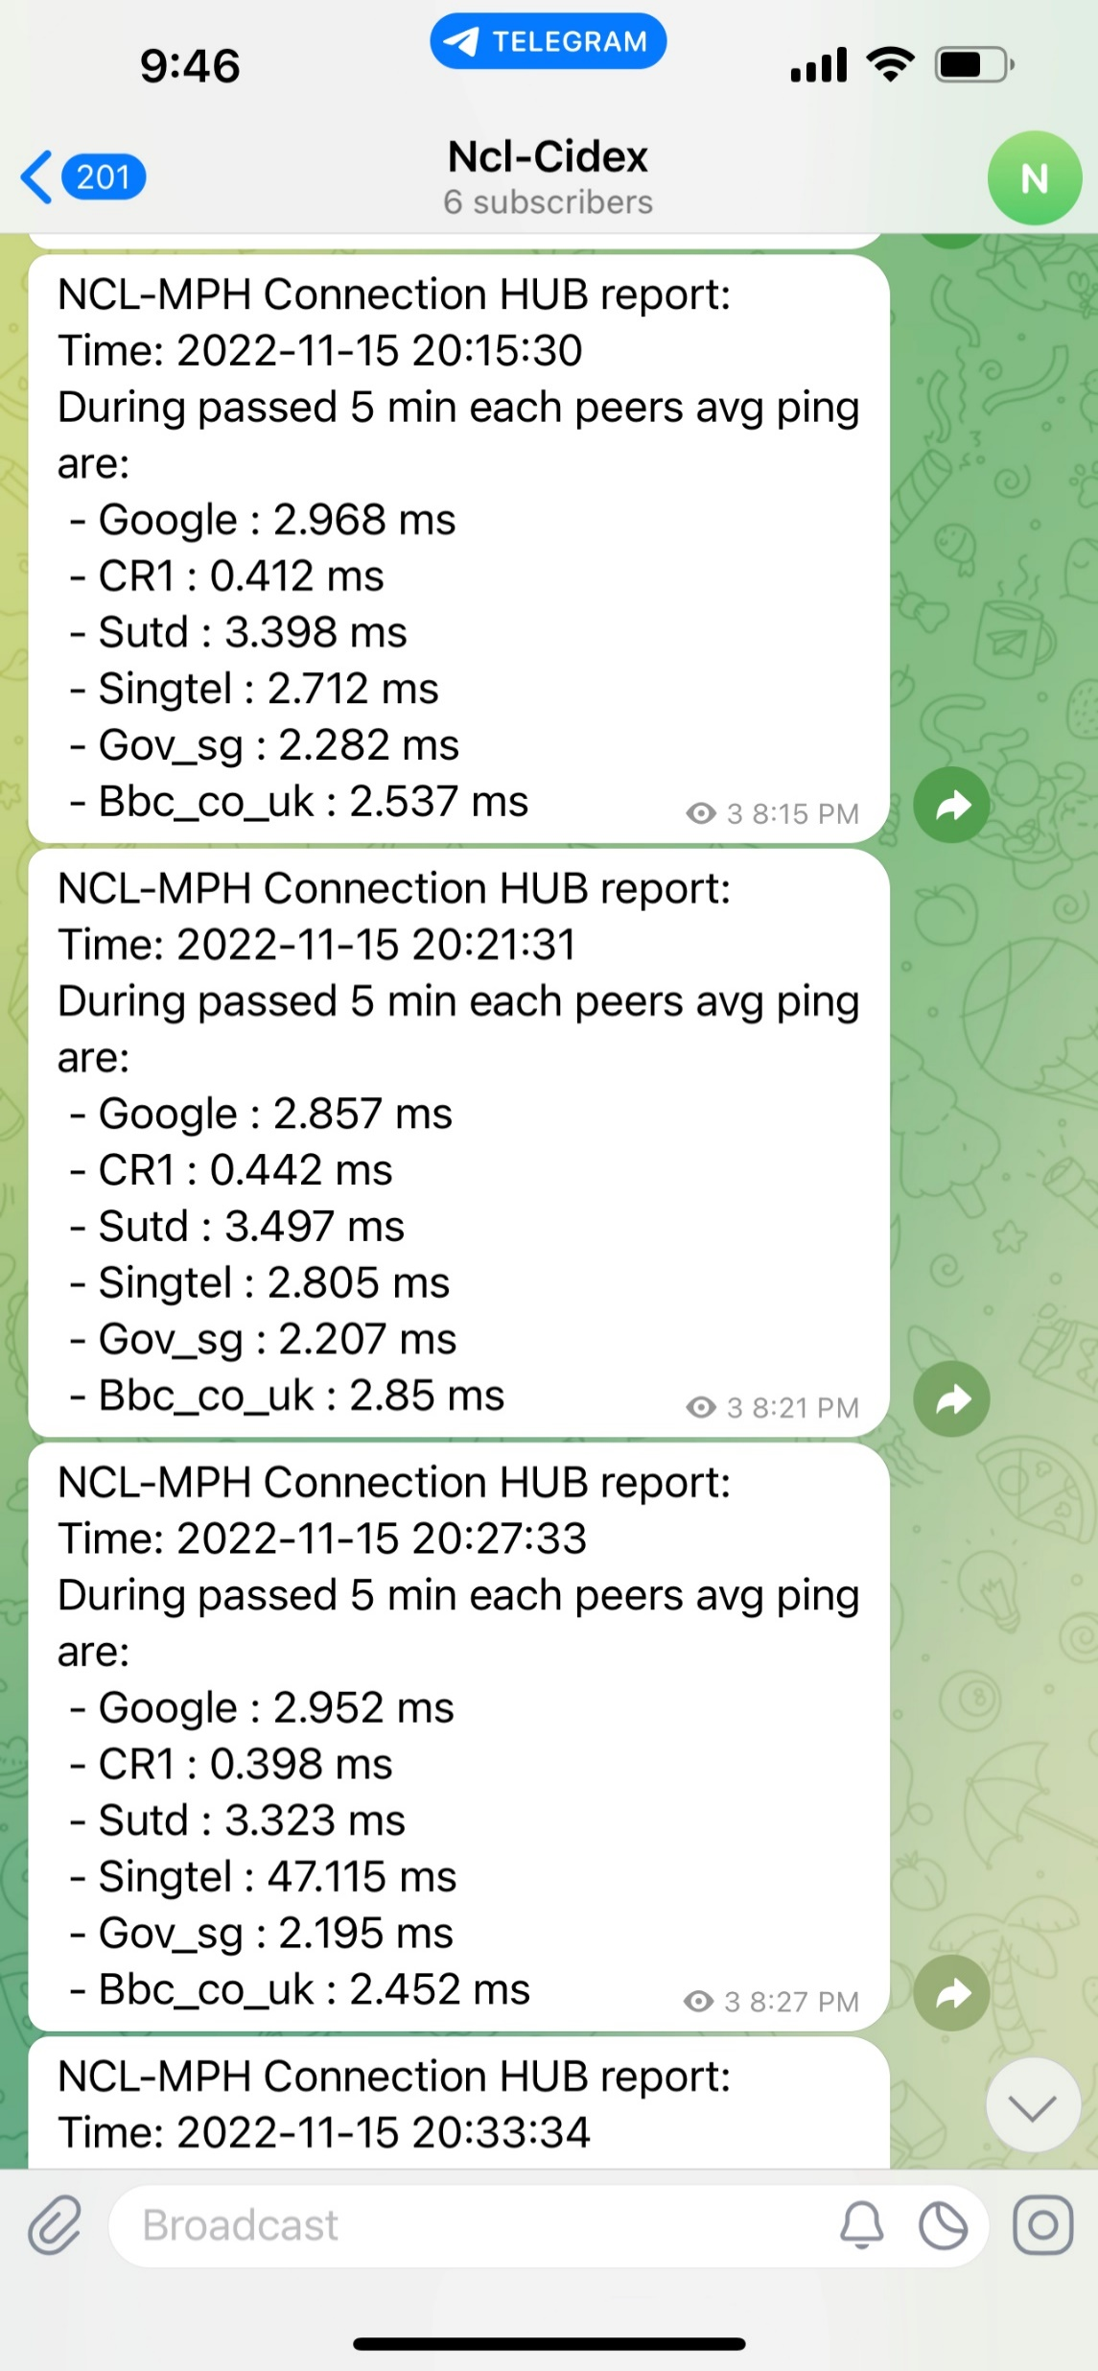

Building a Python Lightweight, Secure Cluster Monitor with InfluxDB and Grafana
CTF Participants
Physical server 1
Raw Database
Main Monitor Dashboards
CTF Challenge Host VMs
Communication Module
…
TX-VM1
TX-VM4
Monitor Hub
Internet
Cpu%,
Ram%, Ping
Data Manager
Network Node Dashboards
Monitor Agent
Firewall and Gateway
Physical server N
…
Monitor Agent
Physical server 14
Telegram Group
Challenge VM State Dashboards
CTF Challenge Host Dockers
Final Info Database
Forward Router
Telegram Alert Message Sender
Monitor Agent
Admin and Support Team
Monitor Agent

Slide 2
CTF Participants
Physical server 1
CTF Challenge Host VMs
Raw Database
…
Communication Module
Monitor Hub
Internet
TX-VM1
TX-VM4
Cpu%,
Ram%, Ping
Monitor Agent
Data Manager
Firewall and Gateway
Physical server N
…
Monitor Agent
Message Sender
Physical server 14
Telegram Group
Info Database
CTF Challenge Host Dockers
Forward Router
Monitor Agent
Monitor Agent
Monitor Dashboards
Admin and Support Team

Slide 3
The cluster’s network topology and the service health of each monitored node/sub-cluster
The online and total service monitored count
Current service score and the score history diagram
Teams/Cluster selection drop down menu.
Service health percentage categorized by services type.
Score history
table of every sub-service cluster.

Slide 4

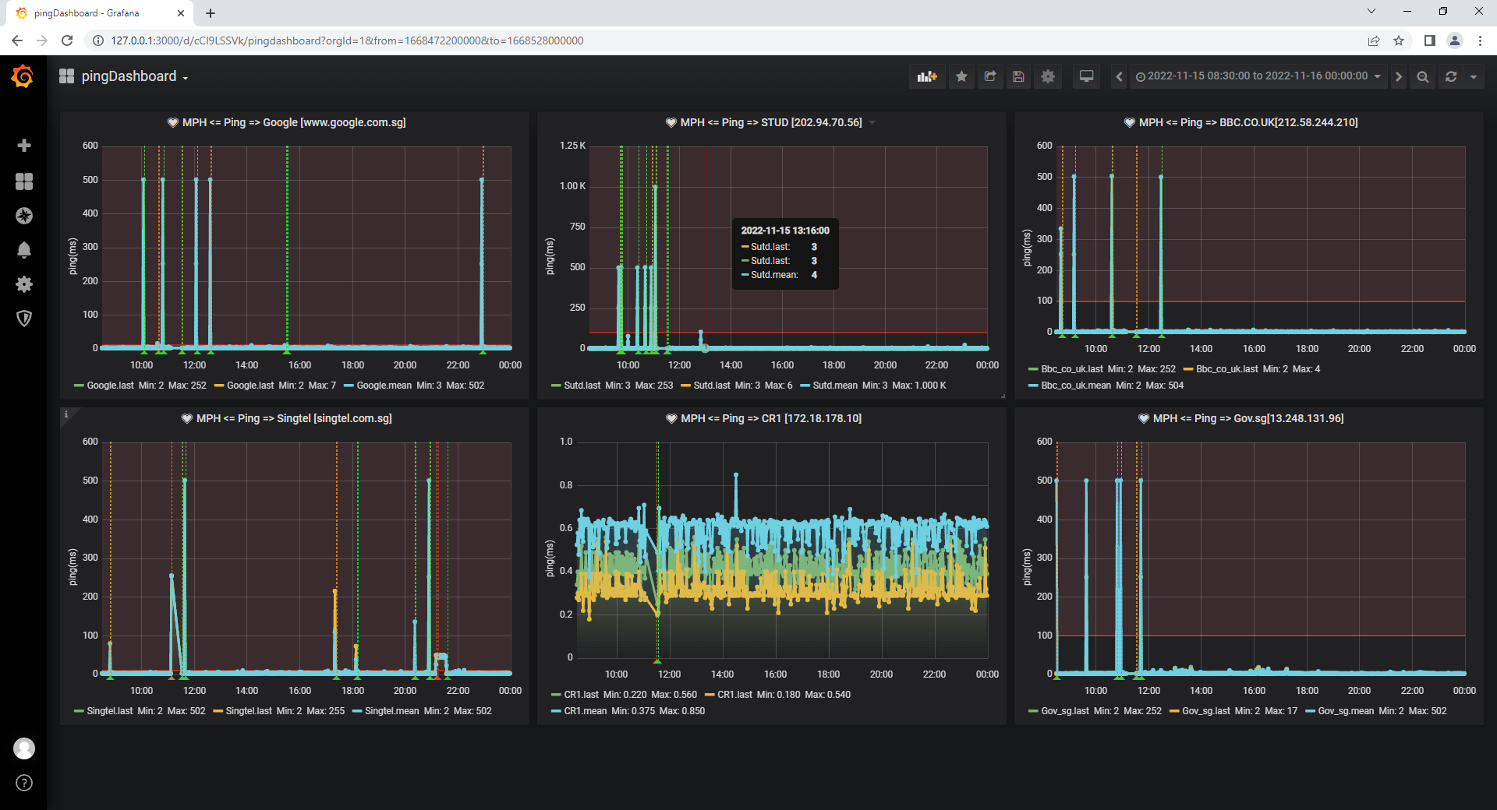
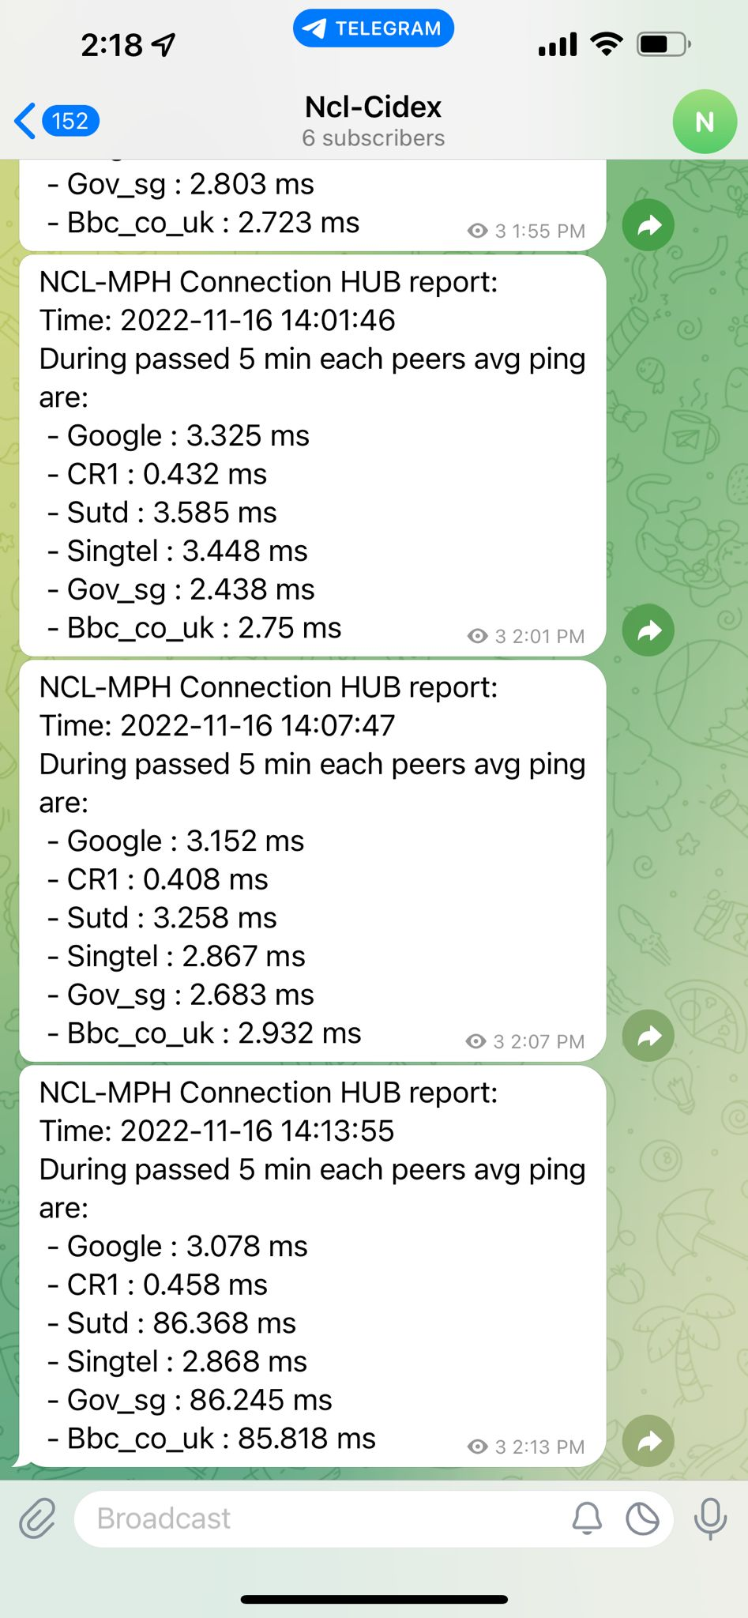
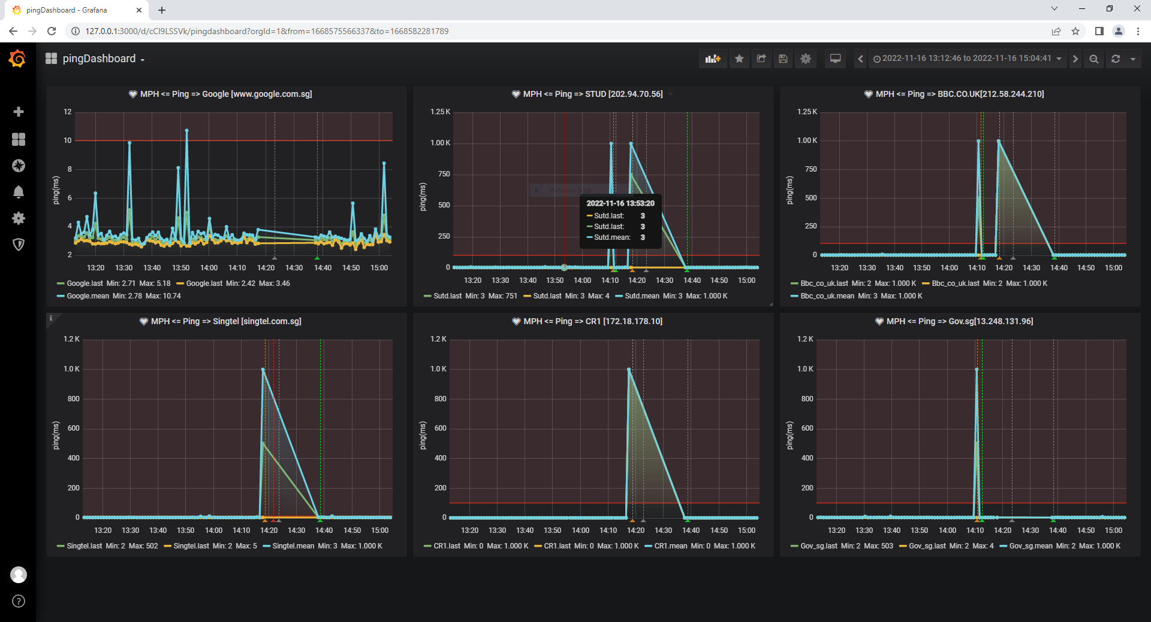
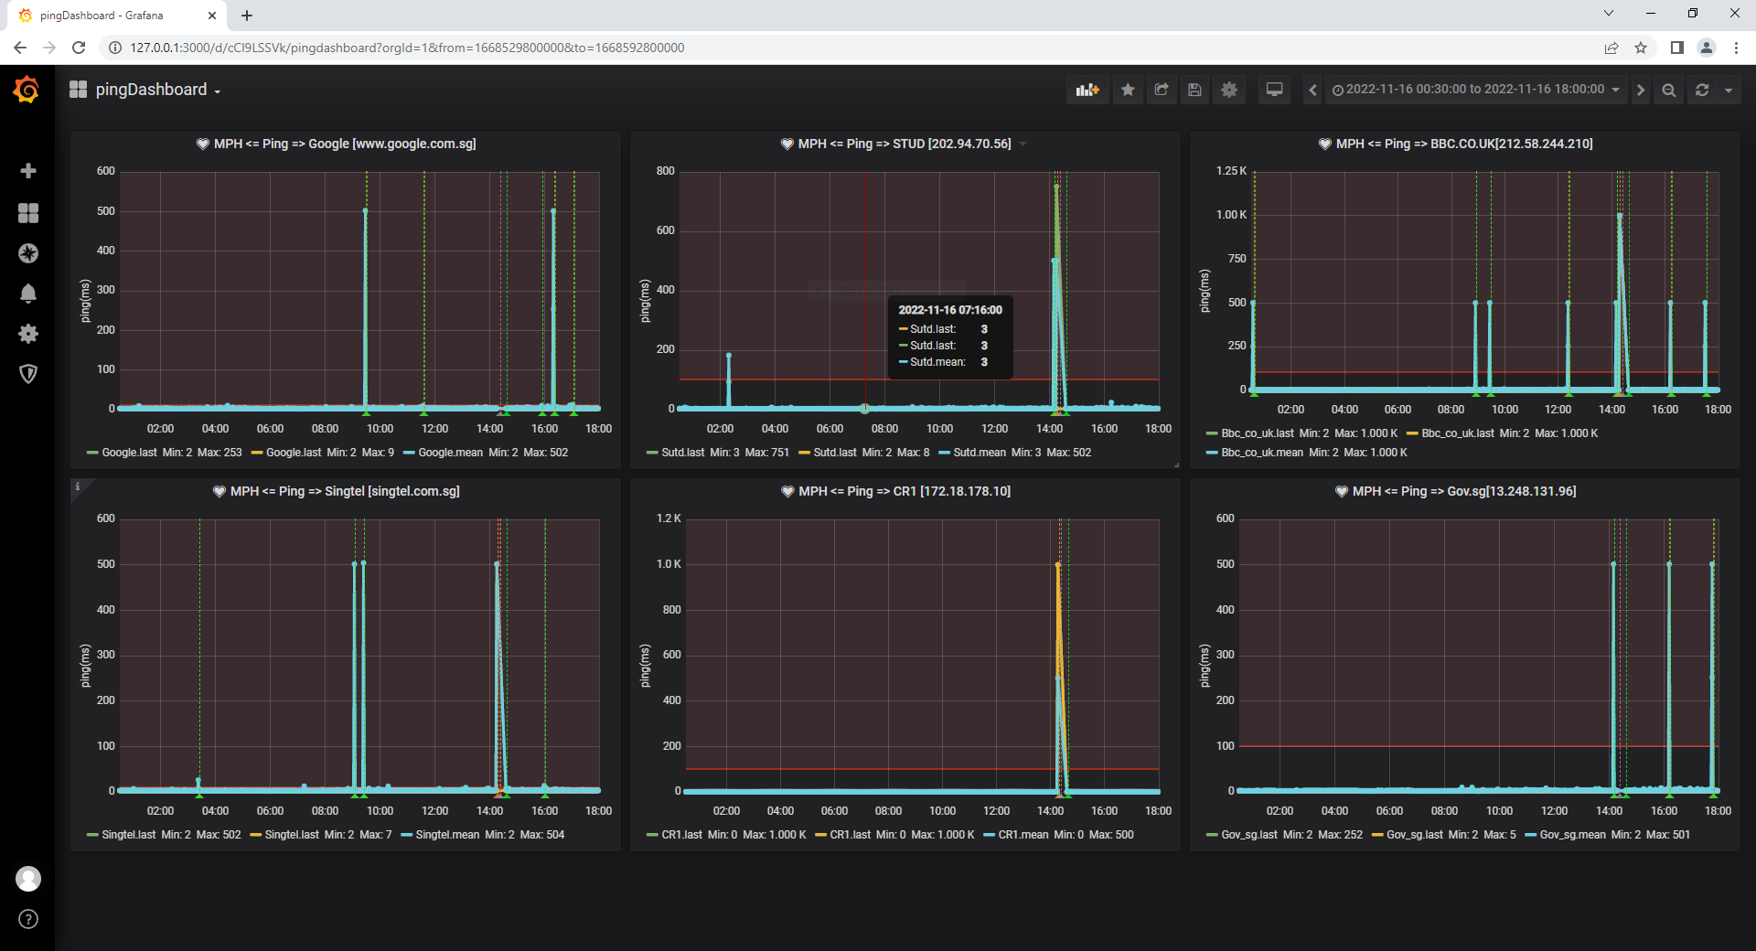
Use Case 1: CIDeX event main venue network monitor [result]
Event day-1 [15/11/2022] entire ping latency chart:
Event monitor result:
Ping client: 900KB raw ping record [text format].
Monitor hub: 600K DB raw + avg data, 1 network interrupt detect and reported.
Telegram-bot: 197 avg ping report in the channel.
Network interrupt [16/11/2022] detection result:
Event day-2 [16/11/2022] entire ping latency chart:

Slide 5
